Slide 1
K-MEANS
CLUSTERING
Sourav Karmakar
souravkarmakar29@gmail.com

Slide 2
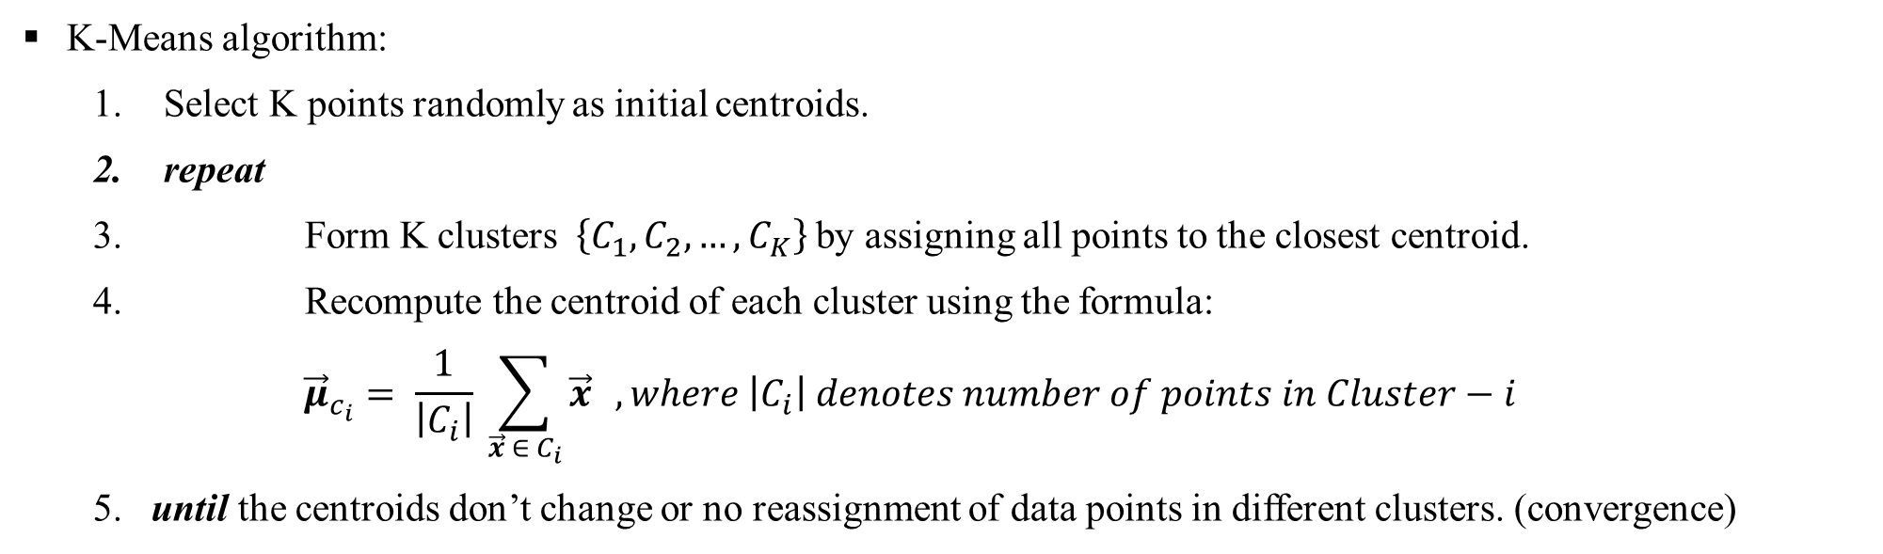
K-MEANS CLUSTERING
K-Means is a partitional clustering algorithm.
The K-means algorithm partitions the given data into K clusters.
Each cluster has a cluster center, called centroid.
K is user specified.

Slide 3
K-MEANS CLUSTERING

Slide 4
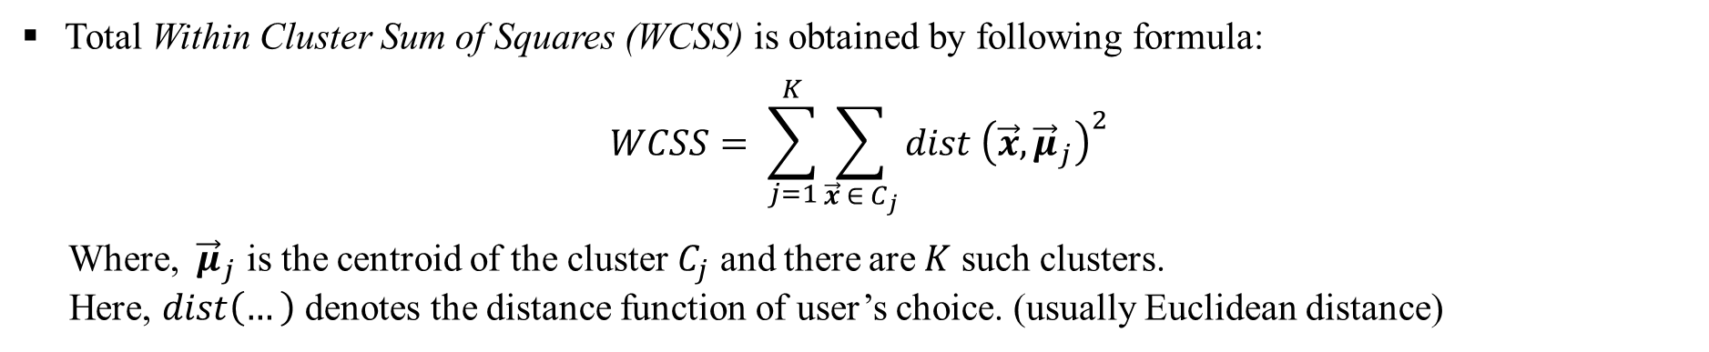
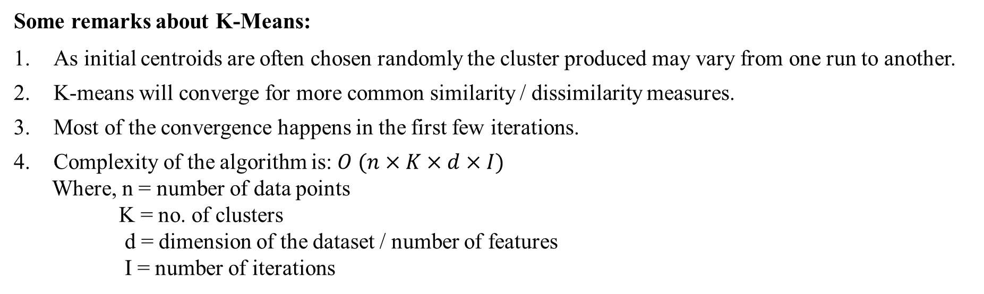
K-MEANS CLUSTERING

Slide 5
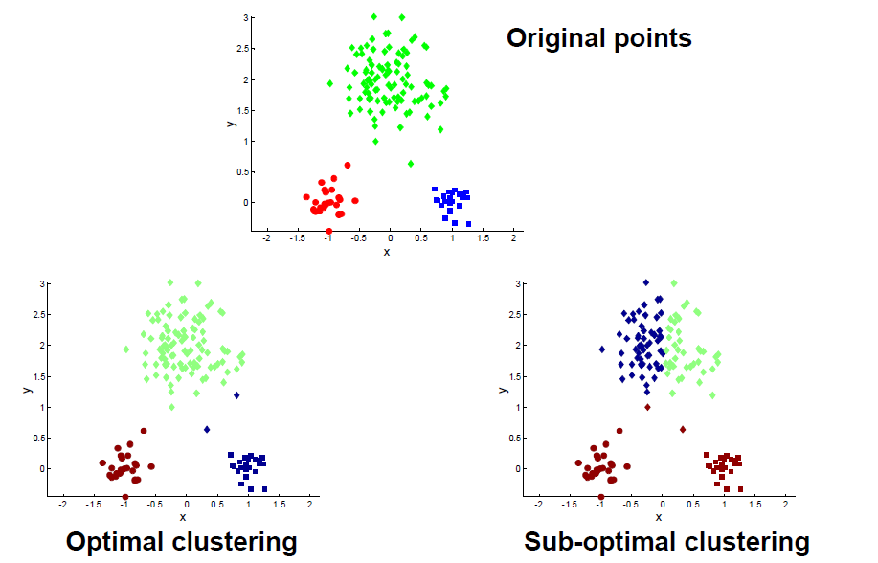
K-MEANS CLUSTERING - LIMITATIONS
Different runs of the K-means algorithm on the same dataset can produce very different results. This is because random selection of initial centroids.

Slide 6
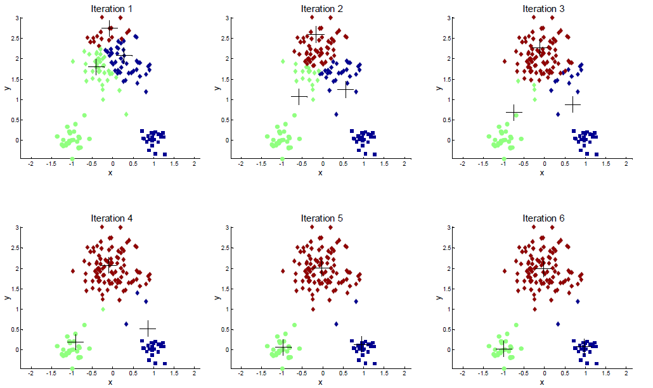
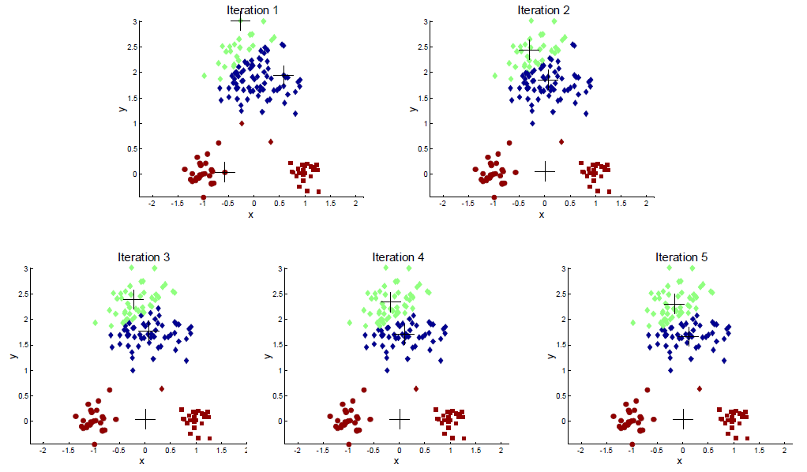
K-MEANS CLUSTERING - LIMITATIONS
RUN-1
RUN-2
Notice that choosing different set of initial centroids have produced completely different clustering on the same dataset.

Slide 7
K-MEANS CLUSTERING - LIMITATIONS
Solution to the initial centroid problem
Pre-process the data.
Normalize / Standardize the data.
Eliminate outliers if possible.
2. Sample the dataset and use Hierarchical Clustering (To be discussed in another lecture) to determine the initial centroids.
3. Select more than K initial centroids and from these select K most widely separated centroids after clustering.
4. Multiple runs and select the one which gives minimum WCSS value.
Post-process the data.
Eliminate small clusters that may represent outliers or noises.
Split ‘loose’ clusters, i.e., clusters with relatively high Sum of Square Error (SSE).
Merge clusters that are ‘close’ and that have relatively low SSE.

Slide 8
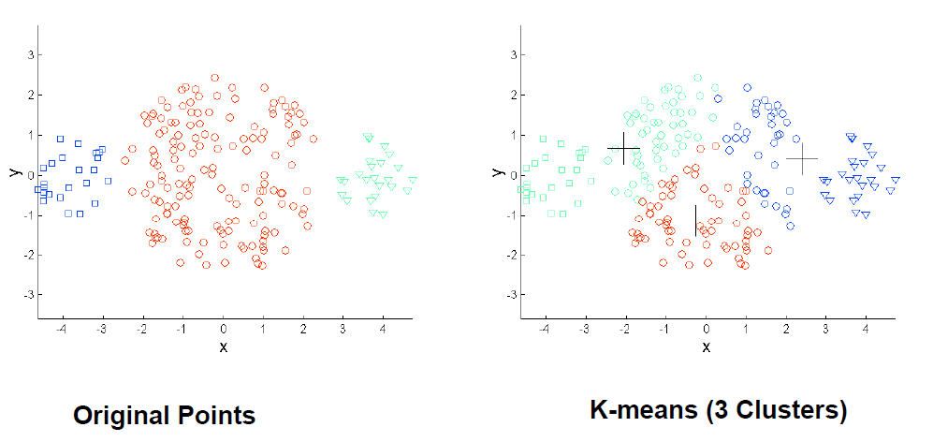
K-MEANS CLUSTERING - LIMITATIONS
K-Means faces problem when the clusters are of different sizes.

Slide 9
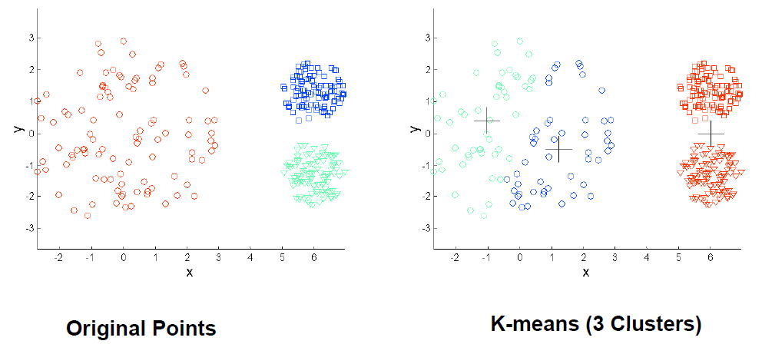
K-MEANS CLUSTERING - LIMITATIONS
K-Means doesn’t work well when the clusters are of different densities.

Slide 10
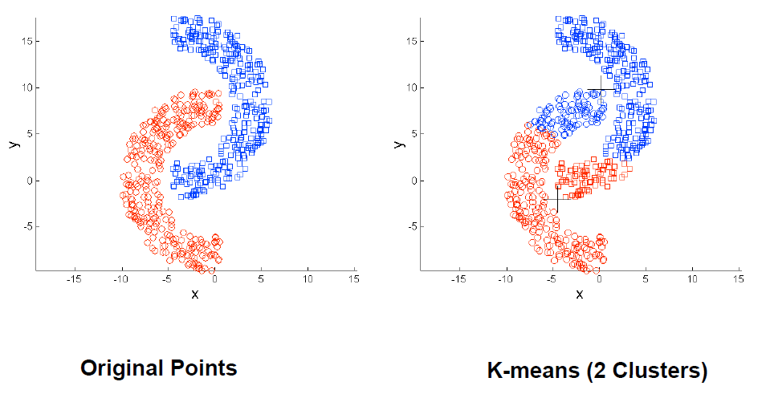
K-MEANS CLUSTERING - LIMITATIONS
K-Means works well when the clusters are of spherical shape. But struggles when the clusters are of non-spherical shape.

Slide 11
Thank You

